Slide 1

My favourite toy
by Stanley Kołakowski

Slide 2

Hello!

Slide 3
Hello!
My name is Stanley

Slide 4
Hello!
My name is Stanley, and my favourite toy is
My name is Stanley

Slide 5

Hello!
My name is Stanley, and my favourite toy is
My name is Stanley

Slide 6
Hello!
My name is Stanley, and my favourite toy is
My name is Stanley
Please ask questions at the end
of my presentation, thanks!

Slide 7
Today I will talk about !
Table of contents:
Some basic information
What you can learn
Where can you watch
Questions?
Sources

Slide 8
Some basic information about
Notes:
WHY “OCTO”?
Octo is 8 in Latin

Slide 9
Some basic information about
Numberblocks are:
Notes:
WHY “OCTO”?
Octo is 8 in Latin

Slide 10
Some basic information about
Numberblocks are:
Segments ■
Notes:
WHY “OCTO”?
Octo is 8 in Latin

Slide 11
Some basic information about
Numberblocks are:
Segments ■
Co l o r f u ll
Notes:
WHY “OCTO”?
Octo is 8 in Latin

Slide 12
Some basic information about
Numberblocks are:
Segments ■
Co l o r f u ll
Number above head
Notes:
WHY “OCTO”?
Octo is 8 in Latin

Slide 13
Some basic information about
Numberblocks are:
Segments ■
Co l o r f u ll
Number above head
Each have unique style
Notes:
WHY “OCTO”?
Octo is 8 in Latin

Slide 14

Some basic information about
Numberblocks are:
Segments ■
Co l o r f u ll
Number above head
Each have unique style
Notes:
WHY “OCTO”?
Octo is 8 in Latin

Slide 15

Some basic information about
Numberblocks are:
Segments ■
Co l o r f u ll
Number above head
Each have unique style
Notes:
WHY “OCTO”?
Octo is 8 in Latin

Slide 16

Some basic information about
Numberblocks are:
Segments ■
Co l o r f u ll
Number above head
Each have unique style
Notes:
WHY “OCTO”?
Octo is 8 in Latin

Slide 17

Some basic information about
Numberblocks are:
Segments ■
Co l o r f u ll
Number above head
Each have unique style
Notes:
WHY “OCTO”?
Octo is 8 in Latin

Slide 18

Some basic information about
Numberblocks are:
Segments ■
Co l o r f u ll
Number above head
Each have unique style
Notes:
WHY “OCTO”?
Octo is 8 in Latin

Slide 19

Some basic information about
Numberblocks are:
Segments ■
Co l o r f u ll
Number above head
Each have unique style
Notes:
WHY “OCTO”?
Octo is 8 in Latin

Slide 20

Some basic information about
Numberblocks are:
Segments ■
Co l o r f u ll
Number above head
Each have unique style
Notes:
WHY “OCTO”?
Octo is 8 in Latin

Slide 21

Some basic information about
Numberblocks are:
Segments ■
Co l o r f u ll
Number above head
Each have unique style
Notes:
WHY “OCTO”?
Octo is 8 in Latin

Slide 22
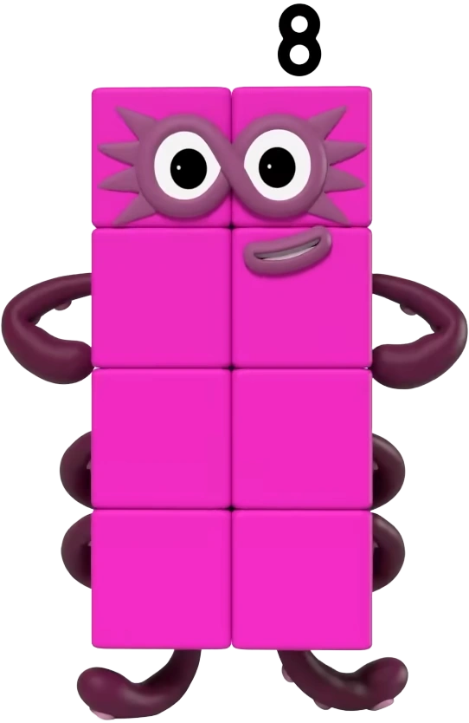
Some basic information about
Numberblocks are:
Segments ■
Co l o r f u ll
Number above head
Each have unique style
Notes:
WHY “OCTO”?
Octo is 8 in Latin

Slide 23

Some basic information about
Numberblocks are:
Segments ■
Co l o r f u ll
Number above head
Each have unique style
Notes:
WHY “OCTO”?
Octo is 8 in Latin

Slide 24
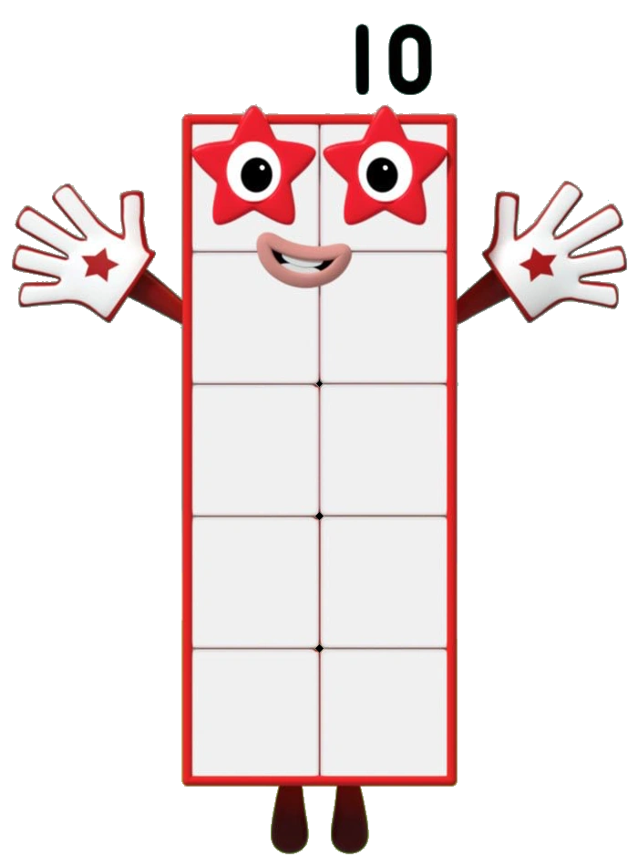
Some basic information about
Numberblocks are:
Segments ■
Co l o r f u ll
Number above head
Each have unique style
Notes:
WHY “OCTO”?
Octo is 8 in Latin

Slide 25
Some basic information about
Numberblocks are:
Segments ■
Co l o r f u ll
Number above head
Each have unique style
Notes:
WHY “OCTO”?
Octo is 8 in Latin

Slide 26
What Can You Learn from ?

Slide 27
What Can You Learn from ?
Addition

Slide 28
What Can You Learn from ?
Addition
Subtraction

Slide 29
What Can You Learn from ?
Addition
Subtraction
Multiplication

Slide 30
What Can You Learn from ?
Addition
Subtraction
Multiplication
Division

Slide 31
What Can You Learn from ? Trivia time!
Addition
Subtraction
Multiplication
Division

Slide 32
What Can You Learn from ? Trivia time!
Addition
Subtraction
Multiplication
Division
10 + 5 = 15

Slide 33
What Can You Learn from ? Trivia time!
Addition
Subtraction
Multiplication
Division
10 + 5 = 15
Notes:
WHY “OCTO”?
Octo is 8 in Latin

Slide 34
What Can You Learn from ? Trivia time!
Addition
Subtraction
Multiplication
Division
10 + 5 = 15
5 + 5 + 5 = 15
Notes:
WHY “OCTO”?
Octo is 8 in Latin

Slide 35
What Can You Learn from ? Trivia time!
Addition
Subtraction
Multiplication
Division
10 + 5 = 15
5 + 5 + 5 = 15
Notes:
WHY “OCTO”?
Octo is 8 in Latin

Slide 36
What Can You Learn from ? Trivia time!
Addition
Subtraction
Multiplication
Division
10 + 5 = 15
5 + 5 + 5 = 15
5 + 3 =
Notes:
WHY “OCTO”?
Octo is 8 in Latin

Slide 37
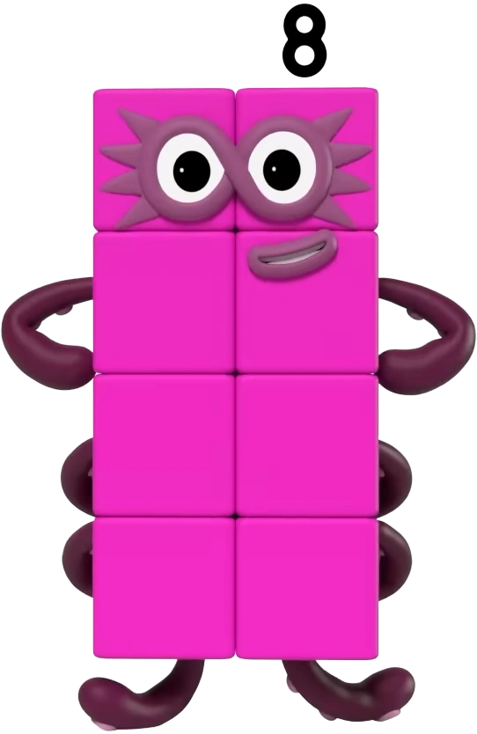
What Can You Learn from ? Trivia time!
Addition
Subtraction
Multiplication
Division
10 + 5 = 15
5 + 5 + 5 = 15
5 + 3 =
Notes:
WHY “OCTO”?
Octo is 8 in Latin

Slide 38
What Can You Learn from ? Trivia time!
Addition
Subtraction
Multiplication
Division
10 + 5 = 15
5 + 5 + 5 = 15
5 + 3 =
10 - 5 = 10
10 - 1 = 9
15 - 1 - 1 - 1 - 1 -
1 - 1 - 1 - 1 - 1 -
1 - 1 - 1 - 1 - 1 = 1
10 - 3 =
Notes:
WHY “OCTO”?
Octo is 8 in Latin

Slide 39
What Can You Learn from ? Trivia time!
Addition
Subtraction
Multiplication
Division
10 + 5 = 15
5 + 5 + 5 = 15
5 + 3 =
15 - 5 = 10
10 - 1 = 9
15 - 1 - 1 - 1 - 1 -
1 - 1 - 1 - 1 - 1 -
1 - 1 - 1 - 1 - 1 = 1
10 - 3 =
Notes:
WHY “OCTO”?
Octo is 8 in Latin

Slide 40
What Can You Learn from ? Trivia time!
Addition
Subtraction
Multiplication
Division
10 + 5 = 15
5 + 5 + 5 = 15
5 + 3 =
15 - 5 = 10
10 - 1 = 9
15 - 1 - 1 - 1 - 1 -
1 - 1 - 1 - 1 - 1 -
1 - 1 - 1 - 1 - 1 = 1
10 - 3 =
Notes:
WHY “OCTO”?
Octo is 8 in Latin

Slide 41
What Can You Learn from ? Trivia time!
Addition
Subtraction
Multiplication
Division
10 + 5 = 15
5 + 5 + 5 = 15
5 + 3 =
15 - 5 = 10
10 - 1 = 9
15 - 1 - 1 - 1 - 1 -
1 - 1 - 1 - 1 - 1 -
1 - 1 - 1 - 1 - 1 = 1
10 - 3 =
Notes:
WHY “OCTO”?
Octo is 8 in Latin

Slide 42
What Can You Learn from ? Trivia time!
Addition
Subtraction
Multiplication
Division
10 + 5 = 15
5 + 5 + 5 = 15
5 + 3 =
15 - 5 = 10
10 - 1 = 9
15 - 1 - 1 - 1 - 1 -
1 - 1 - 1 - 1 - 1 -
1 - 1 - 1 - 1 - 1 = 1
10 - 3 =
Notes:
WHY “OCTO”?
Octo is 8 in Latin

Slide 43
What Can You Learn from ? Trivia time!
Addition
Subtraction
Multiplication
Division
10 + 5 = 15
5 + 5 + 5 = 15
5 + 3 =
15 - 5 = 10
10 - 1 = 9
10 - 3 =

Slide 44

What Can You Learn from ? Trivia time!
Addition
Subtraction
Multiplication
Division
10 + 5 = 15
5 + 5 + 5 = 15
5 + 3 =
15 - 5 = 10
10 - 1 = 9
10 - 3 =

Slide 45
What Can You Learn from ? Trivia time!
Addition
Subtraction
Multiplication
Division
10 + 5 = 15
5 + 5 + 5 = 15
5 + 3 =
15 - 5 = 10
10 - 1 = 9
10 - 3 =
5 × 3 = 15
5 × 1 = 5
2 × 2 =

Slide 46
What Can You Learn from ? Trivia time!
Addition
Subtraction
Multiplication
Division
10 + 5 = 15
5 + 5 + 5 = 15
5 + 3 =
15 - 5 = 10
10 - 1 = 9
10 - 3 =
5 × 3 = 15
5 × 1 = 5
2 × 2 =

Slide 47
What Can You Learn from ? Trivia time!
Addition
Subtraction
Multiplication
Division
10 + 5 = 15
5 + 5 + 5 = 15
5 + 3 =
15 - 5 = 10
10 - 1 = 9
10 - 3 =
5 × 3 = 15
5 × 1 = 5
2 × 2 =

Slide 48
What Can You Learn from ? Trivia time!
Addition
Subtraction
Multiplication
Division
10 + 5 = 15
5 + 5 + 5 = 15
5 + 3 =
15 - 5 = 10
10 - 1 = 9
10 - 3 =
5 × 3 = 15
5 × 1 = 5
2 × 2 =

Slide 49
What Can You Learn from ? Trivia time!
Addition
Subtraction
Multiplication
Division
10 + 5 = 15
5 + 5 + 5 = 15
5 + 3 =
15 - 5 = 10
10 - 1 = 9
10 - 3 =
5 × 3 = 15
5 × 1 = 5
2 × 2 =

Slide 50

What Can You Learn from ? Trivia time!
Addition
Subtraction
Multiplication
Division
10 + 5 = 15
5 + 5 + 5 = 15
5 + 3 =
15 - 5 = 10
10 - 1 = 9
10 - 3 =
5 × 3 = 15
5 × 1 = 5
2 × 2 =

Slide 51
What Can You Learn from ? Trivia time!
Addition
Subtraction
Multiplication
Division
10 + 5 = 15
5 + 5 + 5 = 15
5 + 3 =
15 - 5 = 10
10 - 1 = 9
10 - 3 =
5 × 3 = 15
5 × 1 = 5
2 × 2 =
15 ÷ 3 = 5
50 ÷ 5 = 10
4 ÷ 2 =

Slide 52
What Can You Learn from ? Trivia time!
Addition
Subtraction
Multiplication
Division
10 + 5 = 15
5 + 5 + 5 = 15
5 + 3 =
15 - 5 = 10
10 - 1 = 9
10 - 3 =
5 × 3 = 15
5 × 1 = 5
2 × 2 =
15 ÷ 3 = 5
50 ÷ 5 = 10
4 ÷ 2 =

Slide 53
What Can You Learn from ? Trivia time!
Addition
Subtraction
Multiplication
Division
10 + 5 = 15
5 + 5 + 5 = 15
5 + 3 =
15 - 5 = 10
10 - 1 = 9
10 - 3 =
5 × 3 = 15
5 × 1 = 5
2 × 2 =
15 ÷ 3 = 5
50 ÷ 5 = 10
4 ÷ 2 =

Slide 54
What Can You Learn from ? Trivia time!
Addition
Subtraction
Multiplication
Division
10 + 5 = 15
5 + 5 + 5 = 15
5 + 3 =
15 - 5 = 10
10 - 1 = 9
10 - 3 =
5 × 3 = 15
5 × 1 = 5
2 × 2 =
15 ÷ 3 = 5
50 ÷ 5 = 10
4 ÷ 2 =

Slide 55
What Can You Learn from ? Trivia time!
Addition
Subtraction
Multiplication
Division
10 + 5 = 15
5 + 5 + 5 = 15
5 + 3 =
15 - 5 = 10
10 - 1 = 9
10 - 3 =
5 × 3 = 15
5 × 1 = 5
2 × 2 =
15 ÷ 3 = 5
50 ÷ 5 = 10
4 ÷ 2 =

Slide 56

What Can You Learn from ? Trivia time!
Addition
Subtraction
Multiplication
Division
10 + 5 = 15
5 + 5 + 5 = 15
5 + 3 =
15 - 5 = 10
10 - 1 = 9
10 - 3 =
5 × 3 = 15
5 × 1 = 5
2 × 2 =
15 ÷ 3 = 5
50 ÷ 5 = 10
4 ÷ 2 =

Slide 57
Where can you watch ?

Slide 58


Where can you watch ?

Slide 59
Questions?

Slide 60
Sources
https://en.wikipedia.org/wiki/Numberblocks
https://numberblocks.fandom.com/
https://pl.wikipedia.org/wiki/BBC

Slide 61

Thank you!

